Slide 1
Data Structures

Slide 2
Agenda
Find all anagrams in a String
Minimum Window Substring
Trapping Rain Water
https://practice.geeksforgeeks.org/problems/count-occurences-of-anagrams5839/1
https://practice.geeksforgeeks.org/problems/smallest-window-in-a-string-containing-all-the-characters-of-another-string-1587115621/1/#

Slide 3
Find all Anagrams in a String
txt = forxxorfxdofr
pat = for

Slide 4
Find all Anagrams in a String

Slide 5
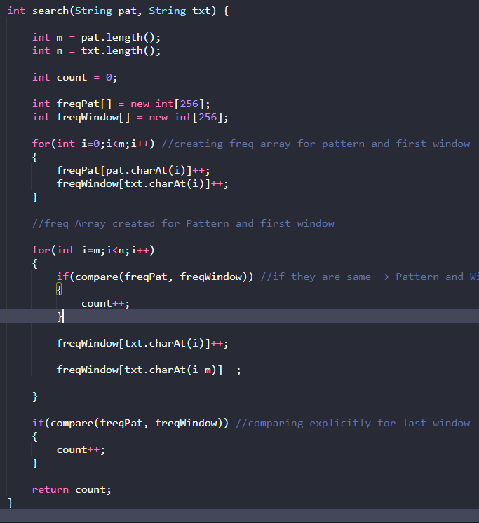
Find all Anagrams in a String

Slide 6
Minimum Window Substring

Slide 7
Minimum Window Substring

Slide 8
Minimum Window Substring

Slide 9
Trapping Rain Water

Slide 10
THANK YOU

